Slide 1


AR & VR IN TOURISM
PRESENTATION
HOME
ABOUT
CONTENT
OTHERS
Augmented & Virtual Reality
Exploring how Augmented Reality (AR) and Virtual Reality (VR) are revolutionizing the tourism industry — transforming the way travelers discover, experience, and engage with destinations around the world.
NEXT SLIDE
AR & VR IN TOURISM: TRANSFORMING TRAVEL EXPERIENCES - AR & VR IN TOURISM: TRANSFORMING TRAVEL EXPERIENCES

Slide 2

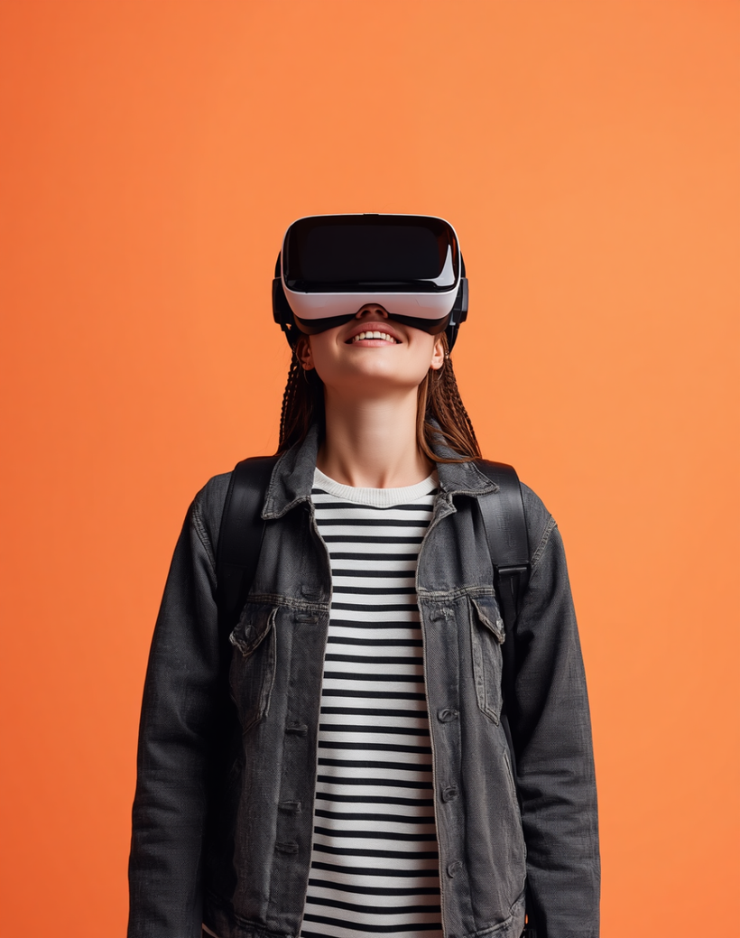
AR & VR IN TOURISM
PRESENTATION
HOME
ABOUT
CONTENT
OTHERS
Introduction
Augmented Reality (AR) and Virtual Reality (VR) are transforming the tourism industry. These immersive technologies enable travelers to explore destinations, cultural sites, and experiences in entirely new ways — bridging the physical and digital worlds to redefine how we discover and engage with the world.
NEXT SLIDE

Slide 3


AR & VR IN TOURISM
PRESENTATION
HOME
ABOUT
AGENDA
OTHERS
This presentation covers the key themes of Augmented and Virtual Reality in Tourism — from foundational concepts to real-world applications and future directions.
NEXT SLIDE
Agenda Overview

Slide 4
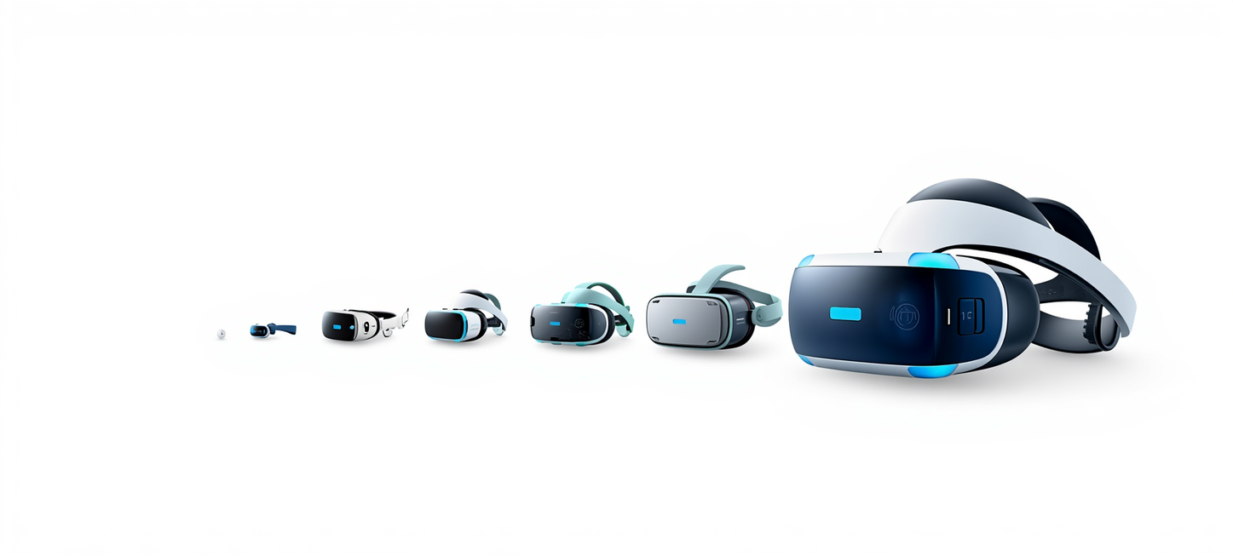
AR & VR IN TOURISM
PRESENTATION
HOME
ABOUT
CONTENT
OTHERS
Evolution of AR & VR
From Ivan Sutherland's 1968 head-mounted display to today's immersive tourism experiences, AR and VR have evolved dramatically. The 1990s saw early VR arcades, while the 2010s brought smartphones and affordable headsets, enabling mainstream adoption in travel and tourism.
NEXT SLIDE

Slide 5
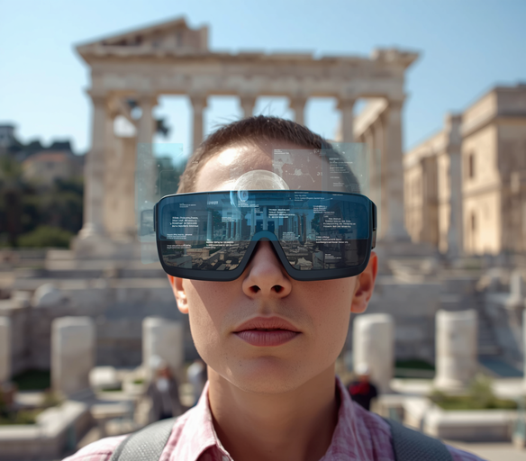
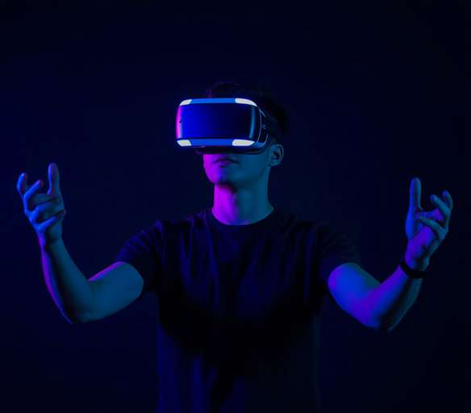
CONSULTING REPORT
PRESENTATION
HOME
ABOUT
CONTENT
OTHERS
AR vs VR
Compared
AR overlays digital content onto the real world, enhancing surroundings with info layers — ideal for navigation and on-site museum guides. VR immerses users in fully virtual environments, perfect for remote destination previews and virtual hotel tours before booking.
NEXT SLIDE

Slide 6
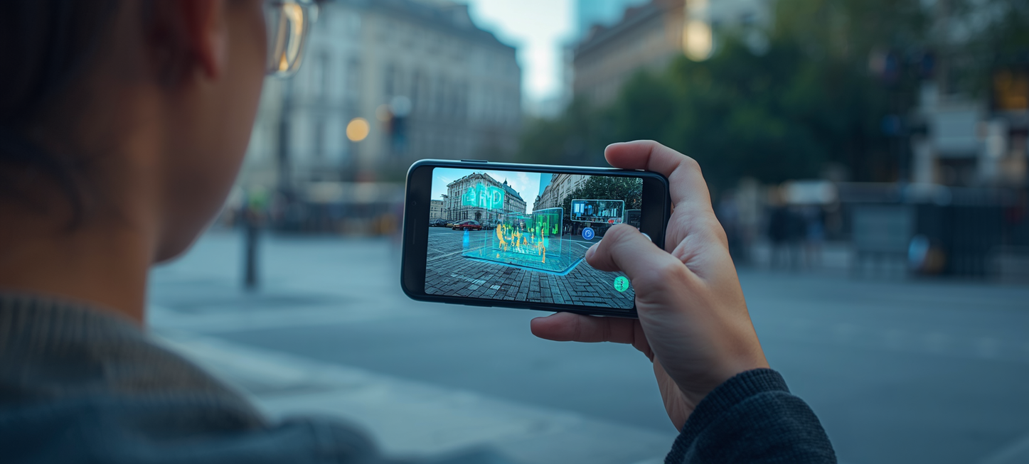
AR & VR IN TOURISM
PRESENTATION
HOME
ABOUT
CONTENT
OTHERS
How AR Works
Augmented Reality overlays digital content onto the real world using cameras, sensors, and displays. Devices such as smartphones, tablets, and AR glasses detect the environment and render interactive 3D elements, text, or images in real time, enhancing the user's physical surroundings.
NEXT SLIDE

Slide 7


CONSULTING REPORT
PRESENTATION
HOME
ABOUT
CONTENT
OTHERS
How VR Works
VR creates fully immersive digital environments using headsets that track head movement and render 360° visuals. Sensors, motion controllers, and spatial audio combine to simulate real-world presence, transporting users into entirely virtual spaces.
NEXT SLIDE

Slide 8
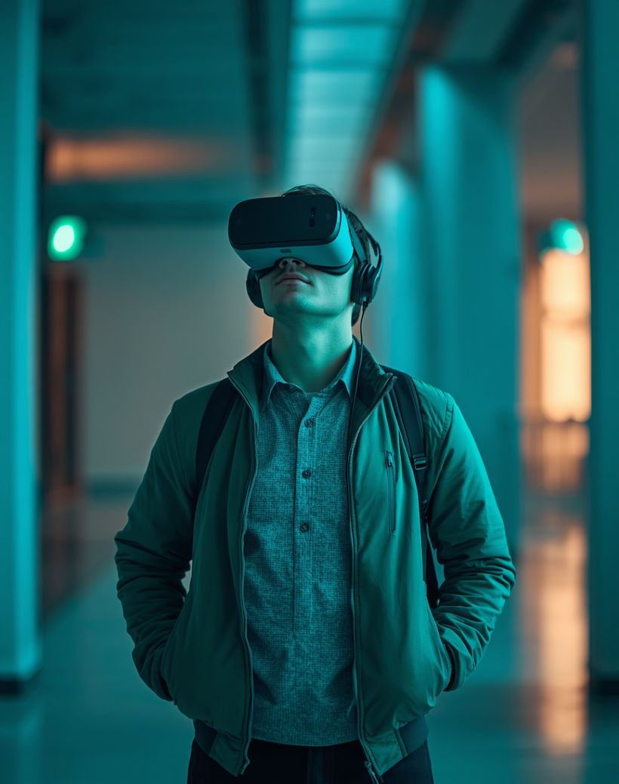
AR/VR IN TOURISM
PRESENTATION
HOME
ABOUT
CONTENT
OTHERS
Applications in Tourism
AR and VR are transforming the tourism industry by offering immersive travel previews, interactive cultural experiences, and enhanced navigation. From virtual destination tours to AR-powered museum exhibits, these technologies redefine how travelers explore and engage with the world.
NEXT SLIDE

Slide 9

AR/VR IN TOURISM
PRESENTATION
HOME
ABOUT
CONTENT
OTHERS
Virtual
Tours
Virtual tours leverage immersive 360° technology to transport users to destinations worldwide without physical travel. From ancient ruins to modern cityscapes, travelers can explore landmarks, hotels, and natural wonders in real time. These experiences enhance pre-trip planning, accessibility, and global reach for tourism providers.

Slide 10
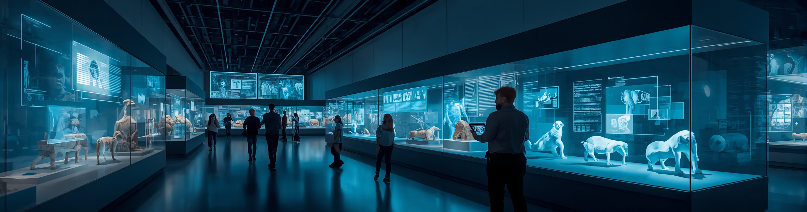
AR/VR IN TOURISM
PRESENTATION
HOME
ABOUT
CONTENT
OTHERS
Smart
Museums
Smart museums leverage AR technology to transform static exhibits into dynamic, interactive experiences. Visitors can scan artifacts to reveal 3D reconstructions, historical timelines, and multilingual audio guides. These innovations deepen cultural engagement and make heritage accessible to all audiences.

Slide 11
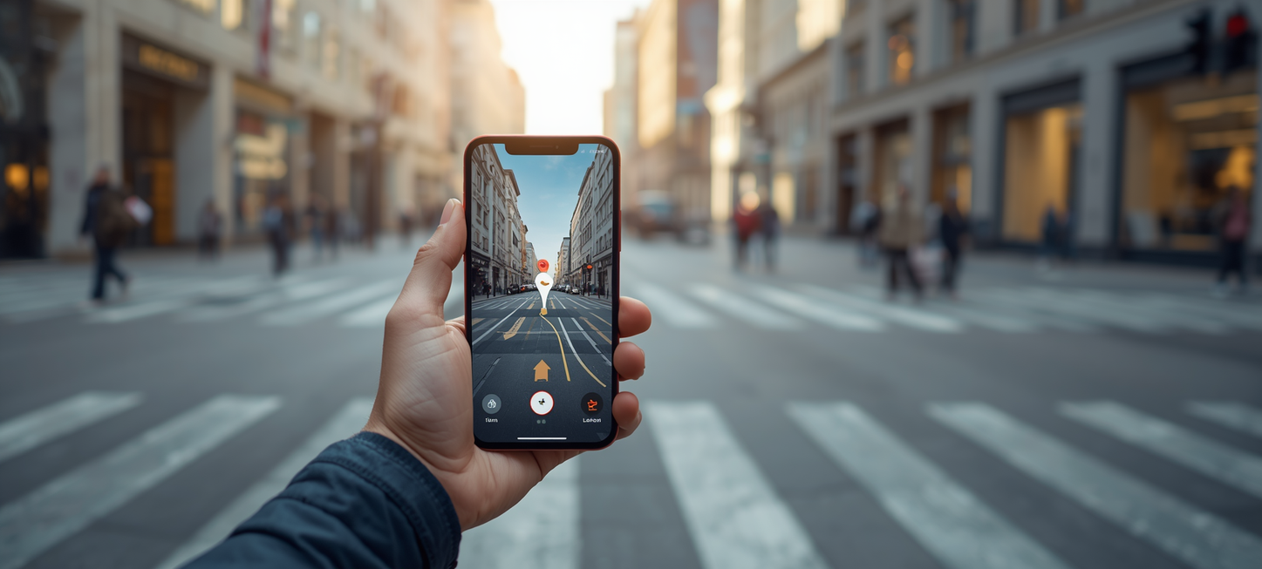
AR & VR IN TOURISM
PRESENTATION
HOME
ABOUT
CONTENT
OTHERS
AR Navigation
AR navigation overlays real-time directions, points of interest, and location-based information directly onto a traveler's view. Using smartphone cameras or AR glasses, tourists can instantly identify landmarks, find routes, and access contextual data about their surroundings.
NEXT SLIDE

Slide 12

CONSULTING REPORT
PRESENTATION
HOME
ABOUT
CONTENT
OTHERS
Hospitality & Hotels
AR and VR are transforming the hospitality industry by enabling virtual room previews before booking, AR-powered concierge services for personalized guest guidance, and immersive in-room experiences. Hotels leverage these technologies to enhance guest satisfaction, streamline check-in processes, and deliver memorable, tech-enhanced stays.

Slide 13
AR & VR IN TOURISM
PRESENTATION
HOME
ABOUT
CONTENT
OTHERS
Benefits &
Advantages
AR & VR technologies deliver powerful benefits in tourism: enhanced visitor engagement through immersive experiences, greater accessibility for travelers with mobility limitations, informed pre-trip planning via virtual previews, and the creation of deeply memorable, personalized journeys that inspire lasting connections.

Slide 14
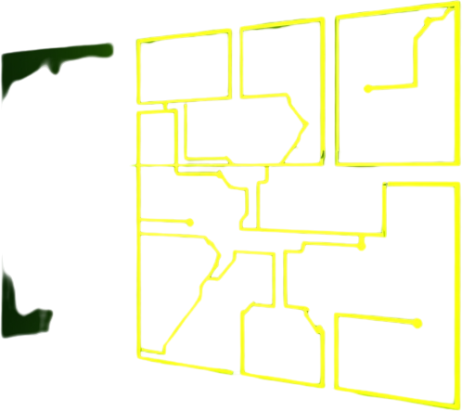
AR & VR IN TOURISM
PRESENTATION
HOME
ABOUT
CONTENT
OTHERS
Challenges &
Barriers
Key challenges include high implementation costs, slow technology adoption, and limited connectivity in remote destinations. User experience barriers such as motion sickness, device accessibility, and lack of digital literacy further hinder widespread AR & VR integration in tourism.

Slide 15
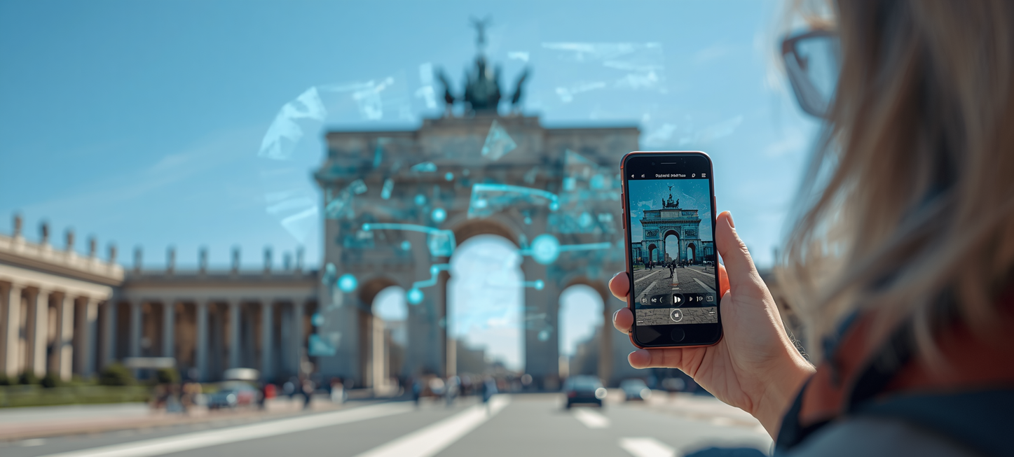
CONSULTING REPORT
PRESENTATION
HOME
ABOUT
CONTENT
OTHERS
Case Studies
Google Arts & Culture enabled virtual museum tours globally. The Louvre's AR app guides visitors through exhibits with immersive overlays. Thomas Cook's VR "Try Before You Fly" campaign boosted bookings by 190%. Japan's AR navigation app transformed tourist wayfinding in Tokyo.
NEXT SLIDE

Slide 16
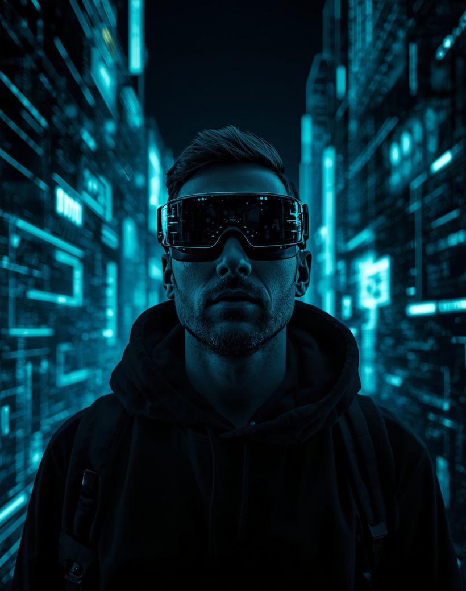
AR/VR IN TOURISM
PRESENTATION
HOME
ABOUT
CONTENT
OTHERS
Future Trends
The future of AR/VR in tourism points to hyper-personalized experiences, AI-driven virtual guides, and 5G-powered immersive travel previews. Haptic feedback, holographic displays, and spatial computing will redefine how travelers explore destinations — both physically and virtually.
NEXT SLIDE

Slide 17

CONSULTING REPORT
PRESENTATION
HOME
ABOUT
CONTENT
OTHERS
AI + AR/VR
Artificial intelligence amplifies the power of AR and VR in tourism by enabling personalized, adaptive experiences. AI-driven algorithms analyze traveler preferences to curate virtual tours, while real-time language translation and smart guides enhance AR navigation. Machine learning optimizes VR simulations, making immersive journeys more realistic and responsive to individual needs.

Slide 18

AR/VR IN TOURISM
PRESENTATION
HOME
ABOUT
CONTENT
OTHERS
Conclusion &
Key Takeaways
AR and VR are revolutionizing tourism by creating immersive, accessible, and personalized travel experiences that transcend physical boundaries.
THANK YOU
From virtual tours and smart museums to AR navigation and AI-driven hospitality, these technologies are shaping the future of how we explore the world.
AR/VR IN TOURISM - THE FUTURE OF IMMERSIVE TRAVEL EXPERIENCES

Slide 19

AR/VR IN TOURISM
PRESENTATION
HOME
ABOUT
REFERENCES
OTHERS
[1] Guttentag, D. (2010). Virtual reality: Applications and implications for tourism. Tourism Management, 31(5), 637-651.
[2] Yung, R., & Khoo-Lattimore, C. (2019). New realities: a systematic literature review on virtual reality and augmented reality in tourism research. Current Issues in Tourism, 22(17), 2056-2081.
[3] tom Dieck, M. C., & Jung, T. (2018). A theoretical model of mobile augmented reality acceptance in urban heritage tourism. Current Issues in Tourism, 21(2), 154-174.
THANK YOU
References &
Further Reading

Slide 20
AR & VR IN TOURISM
PRESENTATION
HOME
ABOUT
CONTENT
OTHERS
Thank You
HELLO@REALLYGREATSITE.COM
-
WWW.REALLYGREATSITE.COM

